Slide 1
SRC Project
ctrl-alt-defeat
Hasti Abbasi Kenarsari
Ryan Wei
Medha Swarnachandrabalaji
Alex Auyon
Kenzie Lam

Slide 2
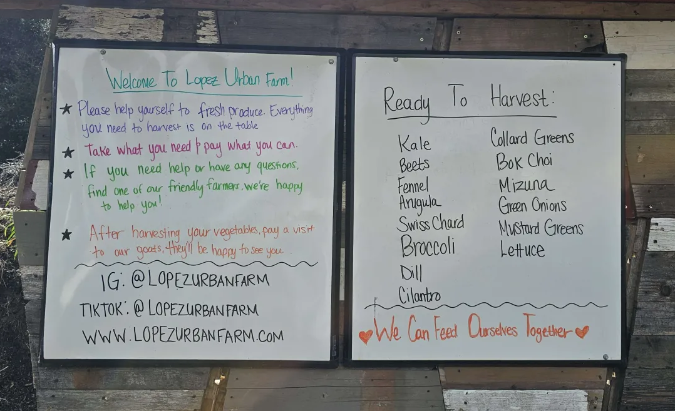
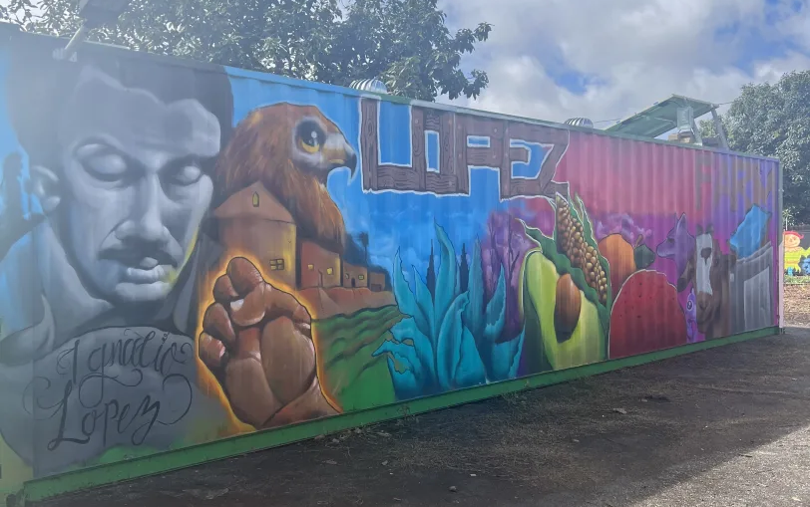
Project Background
h
Systematic method of tracking inventory, donation income, and clientele
Understand client needs, improve operations, and ensure success
Notes:
The farm currently faces challenges in maintaining its bookkeeping, particularly in tracking inventory, donation income, and clientele. The availability of produce is loosely recorded on a whiteboard, and the flow of clients is not adequately documented. This lack of structured record-keeping makes it difficult to understand the specific needs of each client and how the farm can optimally meet those needs while sustaining its operations through donations.
We aim to address this issue by enhancing the farm’s bookkeeping practices. By implementing a more systematic and efficient method of tracking inventory and donations, we hope to better understand their clients’ needs, improve the farm’s operations, and ensure its continued success as a vital resource for the community.

Slide 3
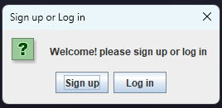
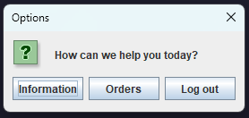
Our Deliverable
a
Customer-facing program
Organization
Accessibility
Structures
Dictionary
List
Notes:
-To address this, we created a customer facing program which allows users to login and choose from the farm’s inventory of produce.
-Through the program, they are able to make orders and see the availability of items, improving the organization of the farm and making products more accessible.
-By utilizing the list and dictionary data structures, we keep track of the clientele and inventory allowing ease of use for both the farm staff and potential customers

Slide 4

Demo
https://drive.google.com/file/d/11bhSNs4khFw6-lxnPsWRyts6km9S-8j0/view?usp=sharing
Notes:
https://drive.google.com/file/d/11bhSNs4khFw6-lxnPsWRyts6km9S-8j0/view?usp=sharing

Slide 5
Implementation
r
Client
Produce
Inventory
ClientBase
LinkedList
SortedLinkedDictionary
Notes:
Talking about implementation
Two encapsulated object, two classes to handle interface, and

Slide 6
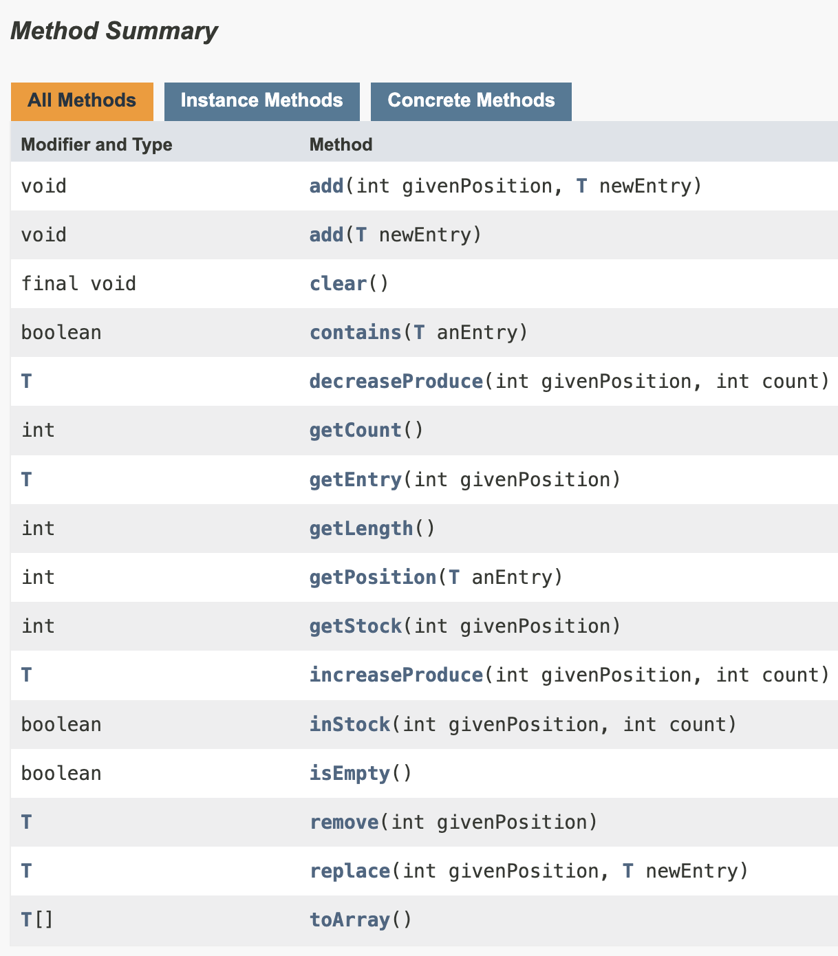
Linked List
h
Pros
Dynamic structure
Efficient insertion/deletion
Uses memory only as needed
Cons
No random access

Slide 7
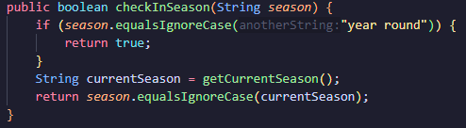
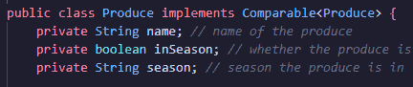

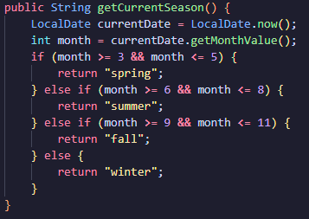
Produce
h

Slide 8
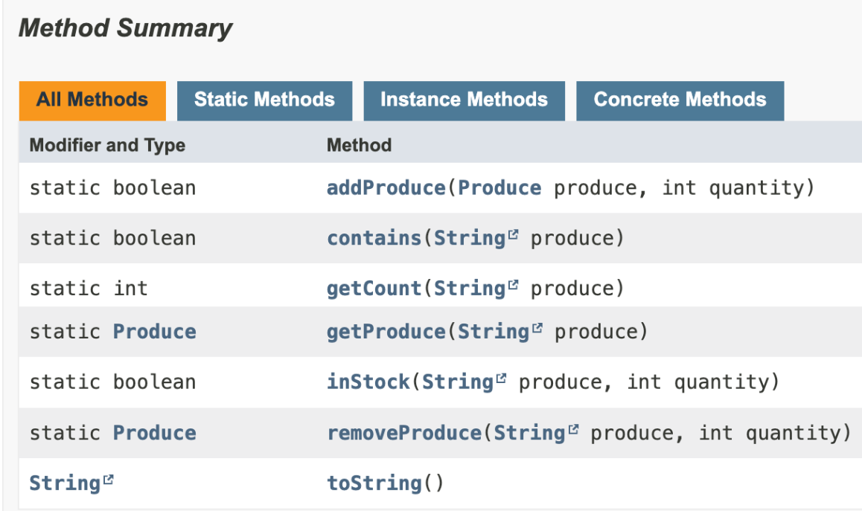
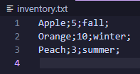
Inventory
h
h
Keeps stock
Read/Save to file
File scanner
Breaks text into tokens

Slide 9
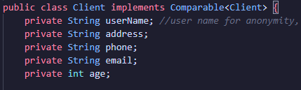

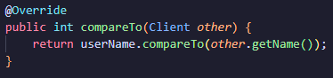
Client
r
Notes:
Client is a comparable

Slide 10
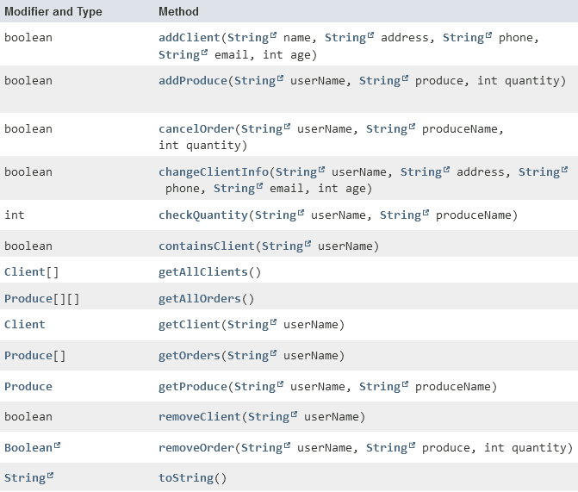
ClientBase
r

Slide 11
ClientBase
r
VS.

Slide 12
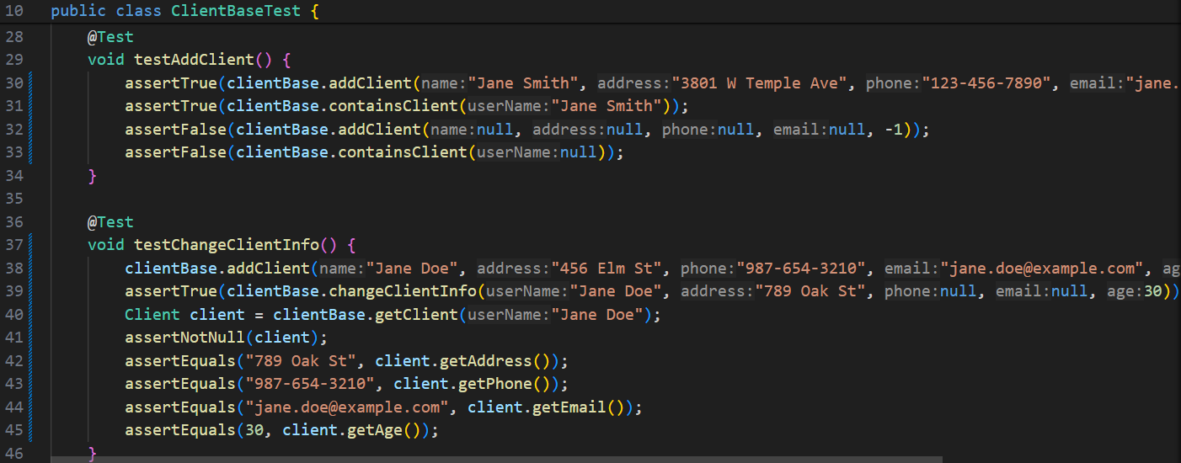
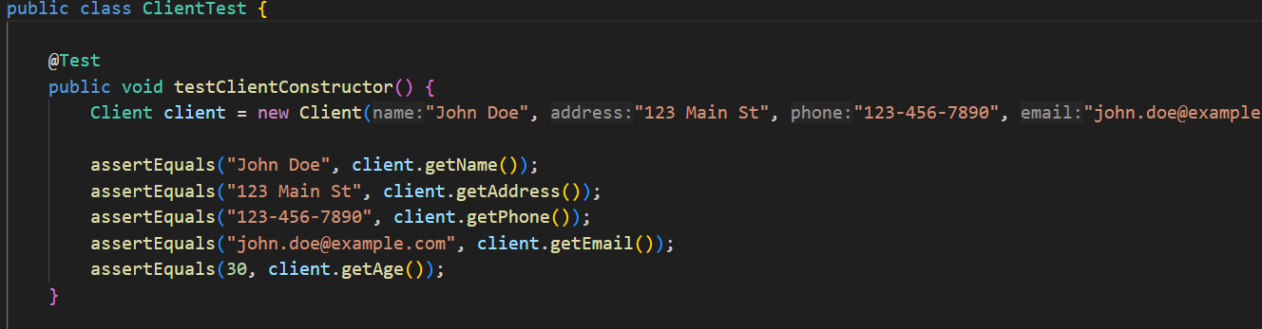
JUnit5 Testing
m
Go through each method in the class and make sure it works as intended
Test for edge cases
Notes:
Make sure proper annotation is there

Slide 13
Things to Improve
m
Different choice of data structures
Bag or Dictionary for inventory
Linked List for Produce
Clearer outline of the project specifications in the future
Notes:
Additionally, instead of using a LinkedList for Inventory, we could have chosen a different data type such as a Bag or a Dictionary for better efficiency. “addProduce” method in clientBase, the Produce array is named “orders”, but it could have been named “produceOrders”. efficiency of clientbase dictionary could be improved by using a LinkedList of produce for the value instead of using an Array of Produce. Specifications = less confusion

Slide 14
Project Future
a
Website/Better UI
Donations
Encrypted Data
Robust Login
Notes:
Launch a website to take order/have a better UI than joptions
System to take donations
Encrypting sensitive data
Better login system with email, password, 2 factor authentication

Slide 15
Contributors
Hasti Abbasi Kenarsari
Coordinated role assignments & mapped out project implementation
Created ListInterface.java, Inventory.java, LinkedList.java, and Node.java
Worked on ClientUI.java and JUnit testing
Generated javadoc files
Medha Swarnachandrabalaji
Worked on ClientUI.java
Worked on JUnit testing
Ryan Wei
Outlined project specifications
Created Client.java, ClientBase.java, DictionaryInterface.java, FarmerUI.java, Produce.java, SortedLinkedDictionary.java, and ClientUI.java
Worked on Inventory.java, LinkedList.java, and JUnit testing
Alex Auyon
Worked on ClientUI.java
Kenzie Lam
Worked on JUnit testing
Notes:
Ending slides

